Slide 1
CS 4031 Compiler Construction Chapter 5
Faryal Saud
Lecturer, Department Computer Science
FAST NUCES CFD

Slide 2
Operator Precedence Parser
This is a technique for constructing shift-reduce parsers by hand for a small class of grammars.
To construct LL(1) parser, there is a restriction on the grammar; grammar should be free of left recursion and should be left factored.

Slide 3
Rules for Operator Precedence Parser
The grammar that does not contain null production and two adjacent non-terminals on the right hand side of any production is called operator grammar
In an operator grammar, no production rule can have:
Epsilon at the right side
Two adjacent non-terminals at the right side

Slide 4
Example:
Not-Suitable grammar Example:
E → E B E | id
B → + | − | =
Suitable grammar Example:
E → E + E | E * E | E = E | id

Slide 5
Shift and Reduce
Let “a” be the top element on stack and “b” is the current element pointed by the input pointer, that is, the look ahead symbol b.
if a ⋖ b or a ≐ b, push b onto the stack and increment input pointer. (Shift action)
if a ⋗ b then (Reduce action) Repeat Pop the stack until the top of the stack is ⋖ to the terminal most recently popped
If a = b = $, announces successful completionss

Slide 6
Precedence:
Low to high Precedence
+, - , *, /, terminals

Slide 7

Using Operator Precedence Relations
$E →E+E \left| E −E \right| E ∗E \left| \frac{E}{E} \right|E \left| −E \right| id$
Then the input string (id + id * id ) with the precedence relations inserted will be :
$ <.id.> + <.id> * <.id> $

Slide 8
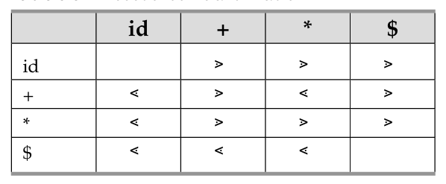
id + id * id
Make the Table

Slide 9
Operator Precedence Grammar Example
What is the equivalent operator grammar for the following grammar?
S → AB
A → c|d
B → aAB |b

Slide 10
Example 2:
Parse the input string a + b * c by using the above algorithm

Slide 11
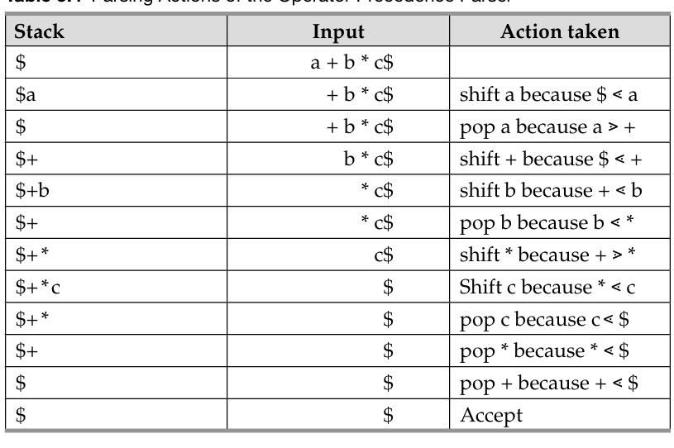
Traversal

Slide 12
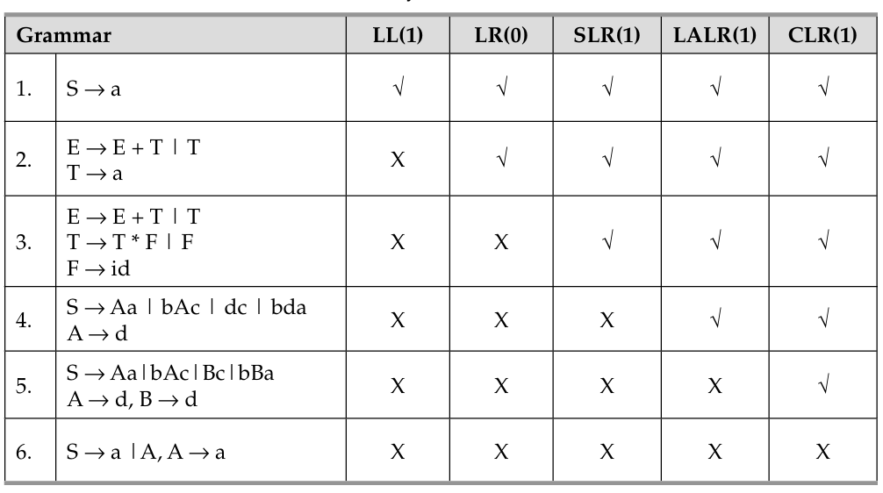
Comparison Between Top-Down and Bottom-Up Parser

Slide 13
Symbol Table

Slide 14
Symbol Table
The symbol table is used to store essential information about every symbol contained within the program.
This includes:
Keywords
Data Types
Operators
Functions
Variables
Procedures
Constants
Literal

Slide 15
Contents of the symbol table
The symbol table will contain the following types of information for the input string in a source program:
The lexem itself
Corresponding tokens
Its semantic component like variable operator constant functions
Data type
Pointers to other entries (when necessary)

Slide 16
Interaction between symbol table and the phases of compiler
Virtually every phase of the compiler will use the symbol table:
Initialization
Scanner
Parser
Semantic action
Intermediate code generation
Object code generation

Slide 17
Phases of compiler
Phase Name | Usage
Initialization | It place keywords, operators, and standard identifiers.
Scanner/Lexical | Place User defined identifiers and Literals Return Token
Syntax Analysis | Place Token and return AST
Semantic Analysis | Place Data types and use for information checking
Intermediate code | Use pointers to entries in symbol table in creating the code
Target Code | Use pointers to entries in symbol table as well as store the address of its procedures and function

Slide 18
Symbol Table
A data structure used by a compiler to keep track of semantics of name.
Determine whether the variable is defined already or not.
Determine the scope
The effective context where a name is valid.
Where it is stored, storage address.
Type checking for semantic correctness determination.

Slide 19
Operations
The common operations of symbol table are
Find / lookup / search
Access the information associated with given name.
Insert
Add a name into the table.
Delete
Remove a name from the table.

Slide 20
Basic Operation of the Symbol Table
Operation | Detail
Adding new symbol | The reserved words, standard identifiers and operators are placed in the Symbol Table during its initialization. New lexemes are added when the scanner encounters them, and they are assigned a token class. Similarly, the semantic analyzer adds the appropriate properties and attributes that belong to the lexeme
Deleting new symbol | When the compiler is finished with a given scope of the program, all the symbols belonging to that scope must be effectively removed before beginning to process a different scope of the program.
Searching symbol | Looking up a lexeme in the symbol table and retrieving any and all of the properties belonging to that symbol.

Slide 21
Symbol Table
uses symbol table to keep track of scope (block) and binding information about names
symbol table is changed (updated) every time
if a new name is discovered
if new information about an existing name is discovered
Symbol table must have mechanism to:
add new entries
find existing information efficiently

Slide 22
Symbol Table
Two common mechanism:
linear lists, simple to implement, poor performance
hash tables, greater programming, good performance
Compiler should be able to grow symbol table dynamically
If size is fixed, it must be large enough for the largest program

Slide 23
Symbol Table Information
For each type name, its type definition (e.g. for the C type declaration typedef int* mytype, it maps the name mytype to a data structure that represents the type int*)
For each variable name, its type. If the variable is an array, it also stores dimension information. It may also store storage class, offset in activation record etc.
For each constant name, its type and value.
For each function and procedure, its formal parameter list and its output type. Each formal parameter must have name, type, type of passing (by- reference or by-value), etc.

Slide 24
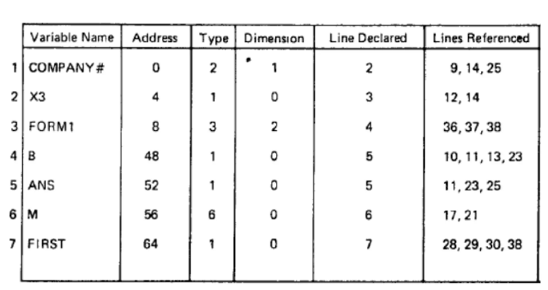
Typical View of Symbol Table

Slide 25
Symbol Table Organization for Non-Block Structured Languages
Each unit of code is a single module that has no sub module.
The complexity of symbol table operation is determined by Average length of search which is average number of comparisons required to retrieve a record.
The collection of attributes stored in the table for a given variable is called symbol table record.
The name of the variable for which an insertion of lookup has to be performed is called search argument.

Slide 26
Symbol Table Organization for Non-Block Structured Languages : Structures
There are four structures
Unordered symbol Table
Ordered Symbol Table
Tree Structured Symbol Table
Hash Symbol Table

Slide 27
Symbol Table
typedef struct {
char *name;
int value;
}

Slide 28
Symbol;
Symbol symbolTable[MAX_SYMBOLS];
int symbolCount = 0;
int lookupSymbol(char *name) {
for (int i = 0; i < symbolCount; i++) {
if (strcmp(symbolTable[i].name, name) == 0) {
return i;
}
}
return -1;
}
void addSymbol(char *name, int value) {
if (lookupSymbol(name) == -1) {
symbolTable[symbolCount].name = strdup(name);
symbolTable[symbolCount].value = value;
symbolCount++;
}
}

